Slide 1
Bellabeat: Smart Marketing Insights from Fitness Data
Presented by: Junior Data Analyst
Date: August 6, 2025

Slide 2

The Business Task: Finding Growth Opportunities
Our analysis focused on three key questions:
What are the common trends in smart device usage?
How could these trends apply to Bellabeat's customers?
How can these trends help influence Bellabeat's marketing strategy?
Our goal was to analyze how consumers use non-Bellabeat smart devices to uncover trends that can guide our marketing strategy.

Slide 3
Our Approach: The Data Analysis Process
Data Source: Fitbit Fitness Tracker Data (30 users over 31 days).
Tools Used: Python, with Pandas for data manipulation and Matplotlib/Seaborn for visualization.

Slide 4
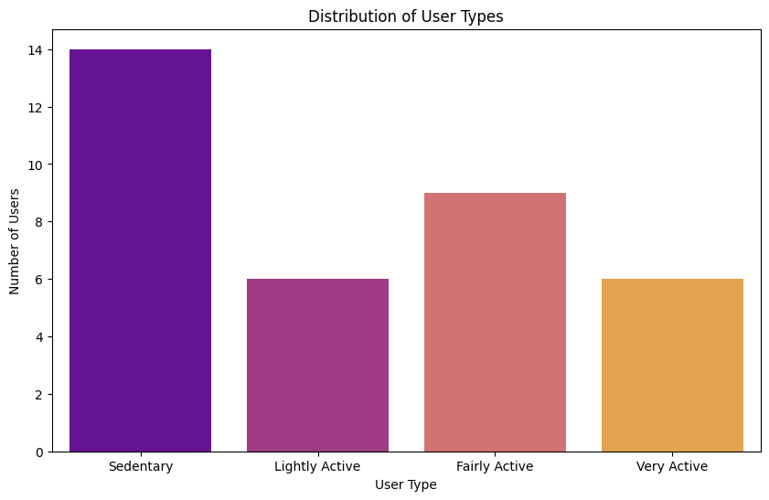
The "Average User" is a Myth
Users fall into distinct activity groups, with most users being Sedentary

Slide 5
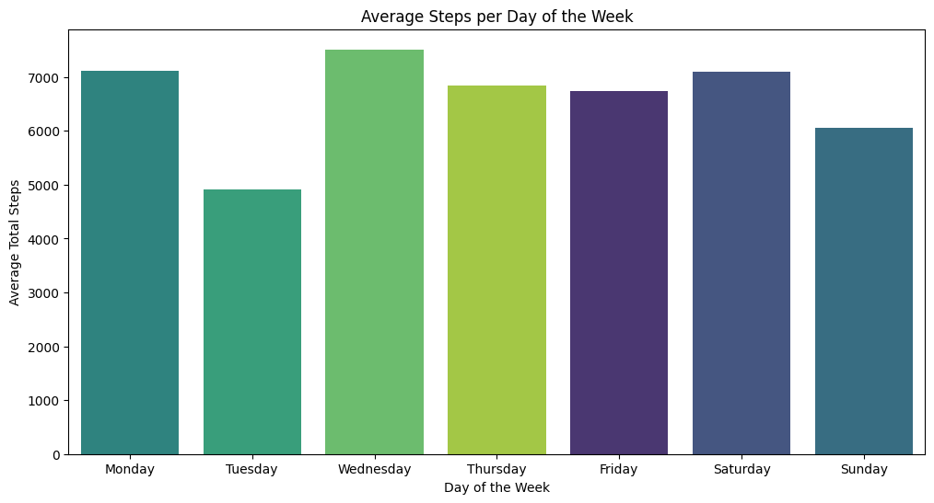
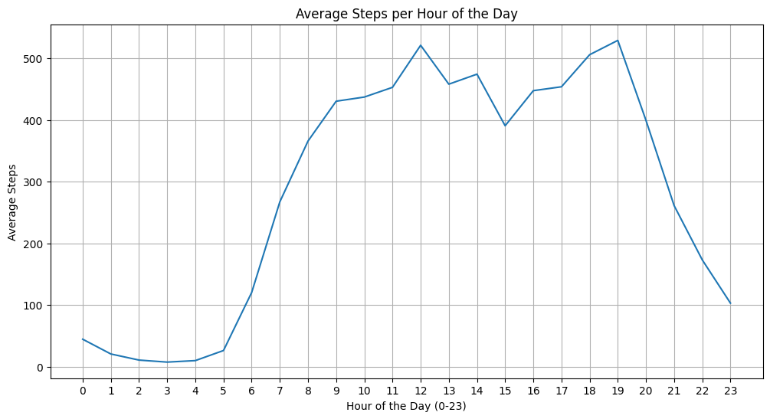
Activity Peaks in Evenings & Weekends
Insight: User activity increases:
Evenings (post 5 PM)
Weekends

Slide 6
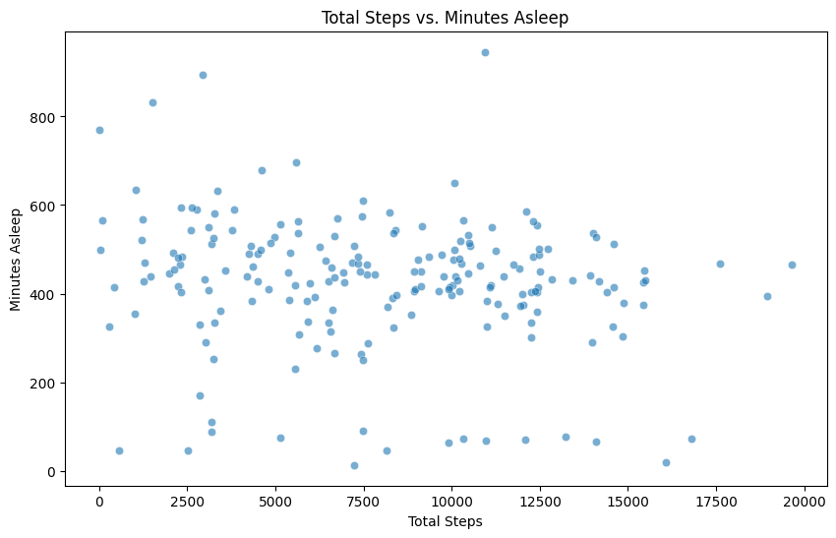
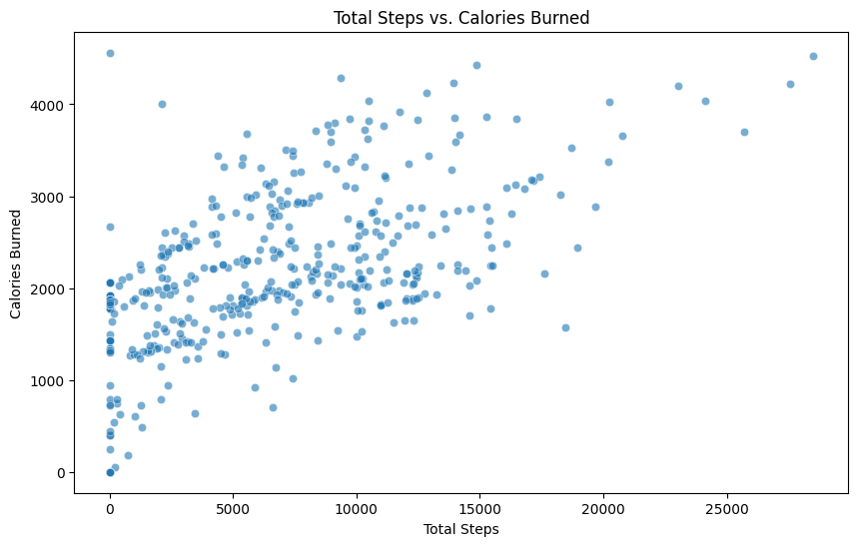
Sleep is an Untapped Opportunity
Weak correlation between activity and sleep duration.

Slide 7
Target the Sedentary User
Educate on the Power of Rest
Marketing Message: Shift the focus from weight loss to the mental and emotional benefits of light activity.
Product Focus: Heavily promote the Bellabeat Leaf. Its stylish, clip-on design is perfect for all-day, discreet tracking that doesn't scream "fitness fanatic."
App Feature: Highlight the app's inactivity alerts. Frame them as gentle nudges and helpful reminders, not demands.
Position Bellabeat as a holistic wellness partner that values recovery as much as activity.
Content Strategy: Develop an educational content series (blogs, videos, social media) on "The Activity-Sleep Connection."
Product Focus: Market the advanced sleep tracking features of the Bellabeat Time and Leaf. Show users how Bellabeat provides insights, not just data.
Membership Promotion: Frame the Bellabeat Membership as the key to unlocking personalized guidance on how to balance activity and recovery for optimal health.
Engage When Users Are Active
Align our marketing calendar with the daily and weekly habits of our users.
Social Media: Schedule motivational posts, workout tips, and user stories to be published between 5 PM and 7 PM on weekdays.
In-App Challenges: Launch fun, low-pressure weekend step challenges to capitalize on the natural increase in weekend activity.
Content Marketing: Create blog posts and videos with titles like "The Perfect 20-Minute Walk to De-Stress After Work."

Slide 8
Thank You
Any Question?

